Slide 1
SOCIOECONOMIC FACTORS OF WATER POLLUTION
Welcome to our project!

Slide 2
1. Water in California
An exploration of water quality regulation.

Slide 3
Californian Water
This state’s water systems supply water to 30 million people
Provides to over 5,680,000 acres of farmland
This makes it one of the largest and most productive water systems globally
How safe and clean does this water end up being?

Slide 4
Water Regulation in California
Establishing safe water for humans and the environment poses complex problems
Water regulation in CA accelerated in the 1960s, with the acts such as the Clean Water Act
Many additional standards and regulation have been put in place, including the use of pesticides and hazardous waste sites

Slide 5
2. The Problem
Water pollution poses a serious threat in CA

Slide 6
“... a lot of people might be surprised to learn that, given how wealthy the state of California is, we still don’t have universal access to clean drinking water”
Lara Cushing, assistant professor at UCLA

Slide 7
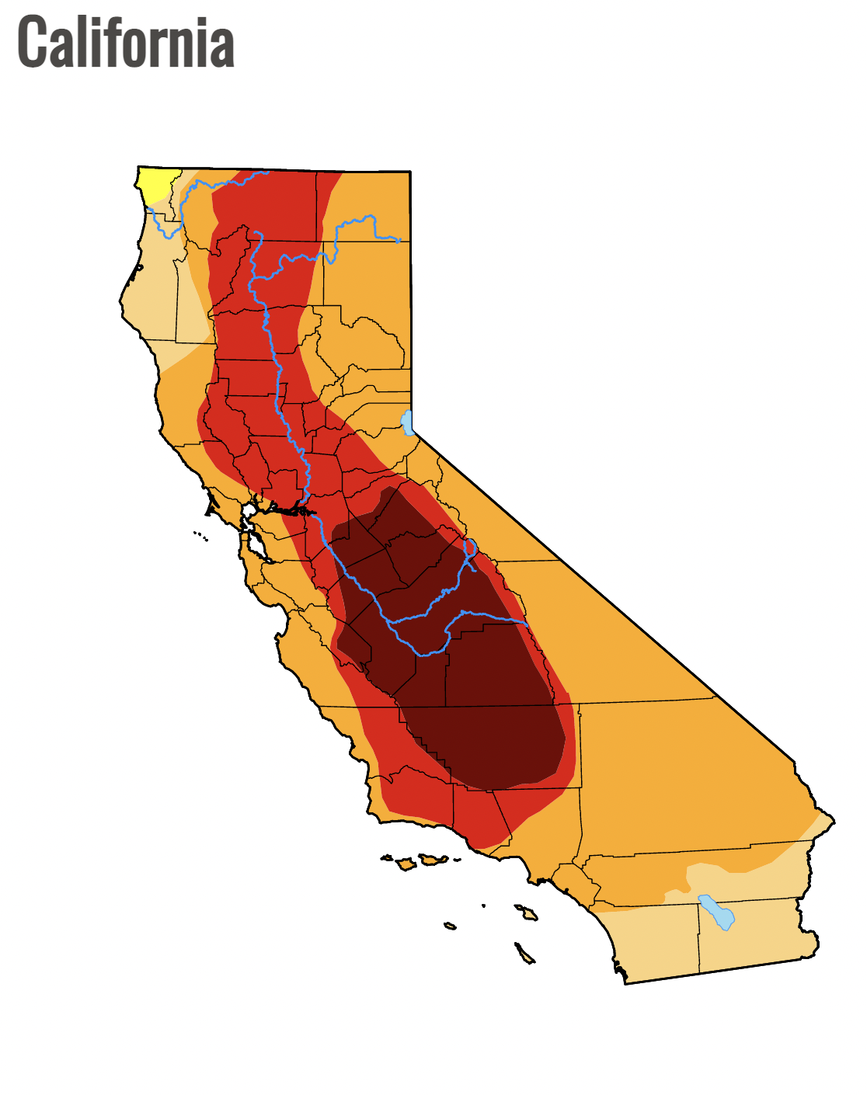
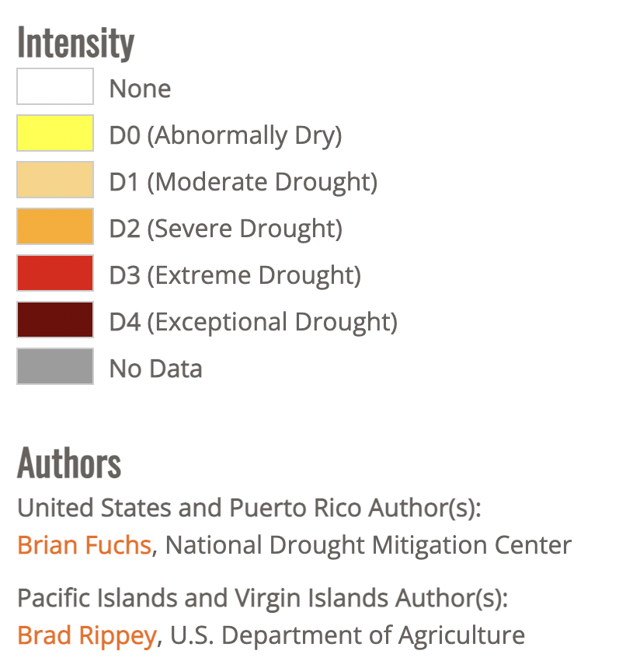
Water Pollution in California
Small Communities
Roughly 400 rural water systems and schools cannot provide adequate drinking water.
Extended Droughts
California droughts have exacerbated these inequalities.

Slide 8
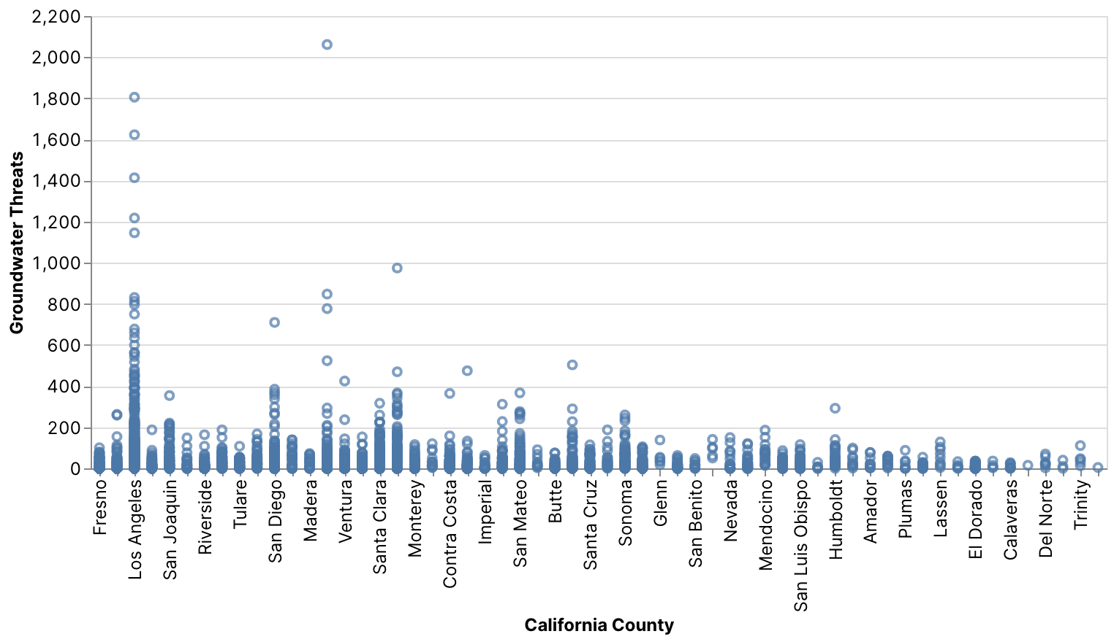
Causes of Water Crisis
Groundwater Threats
Sacramento
Los Angeles
30% of California’s water come from groundwater

Slide 9
3. Our Data Analysis
How did we approach and evaluate water pollution injustice in CA?
[Deepnote Project]

Slide 10
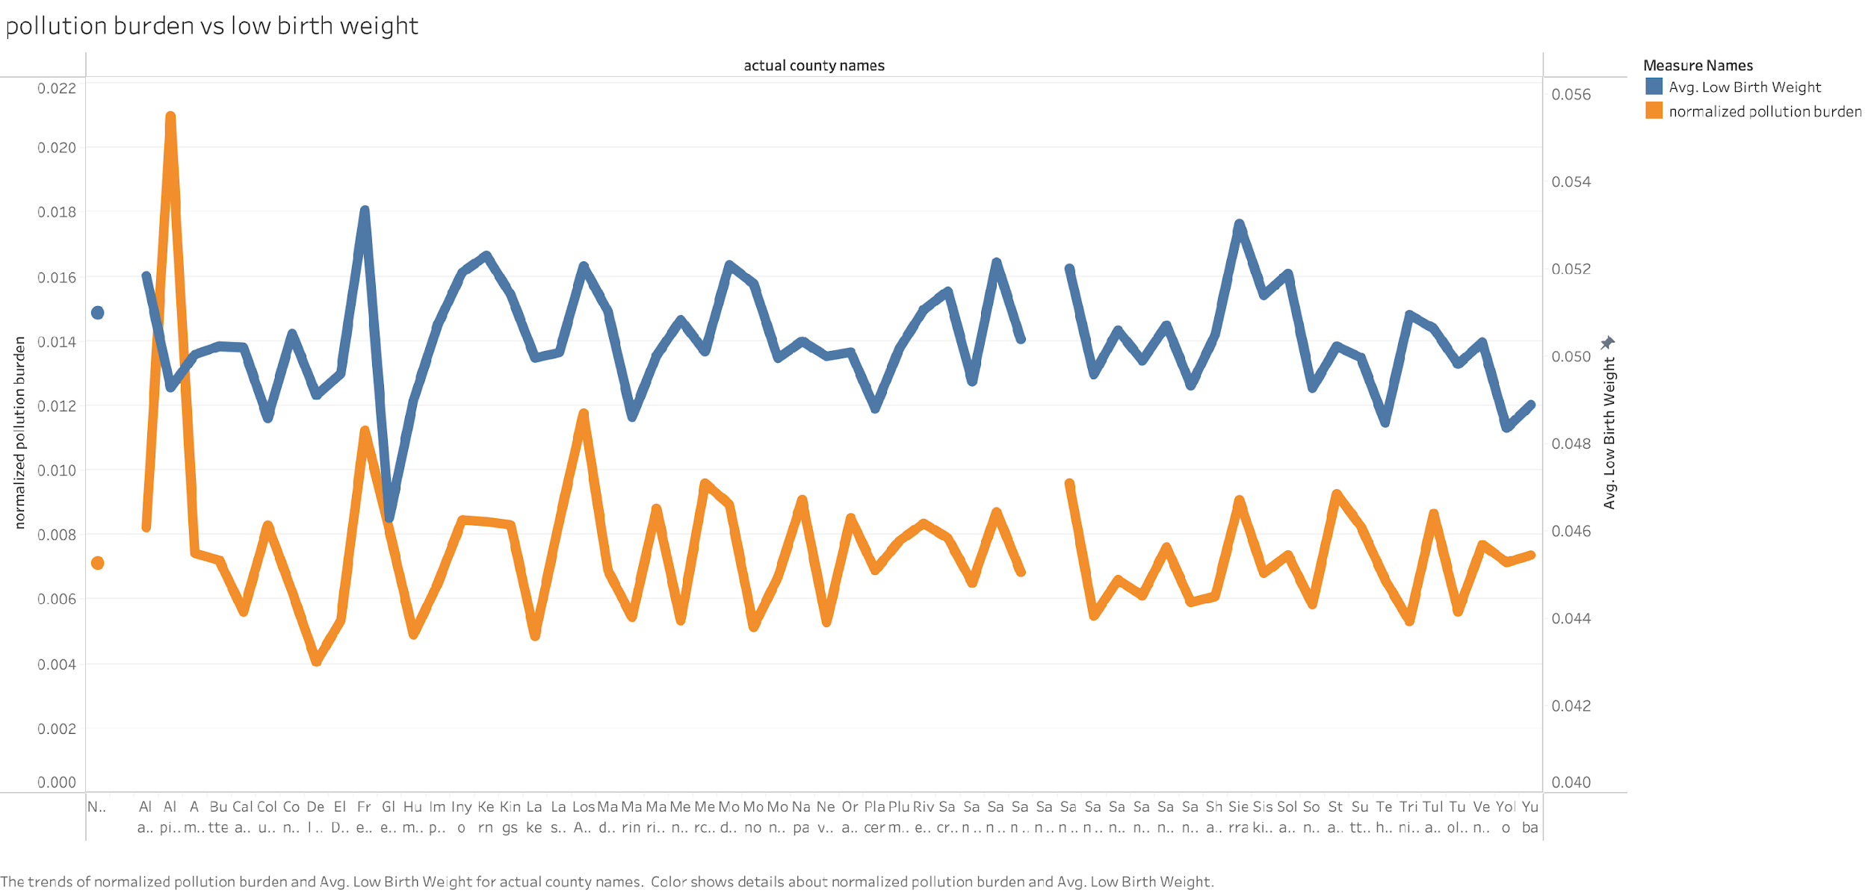
1. Pollution burden vs Low birth weight

Slide 11
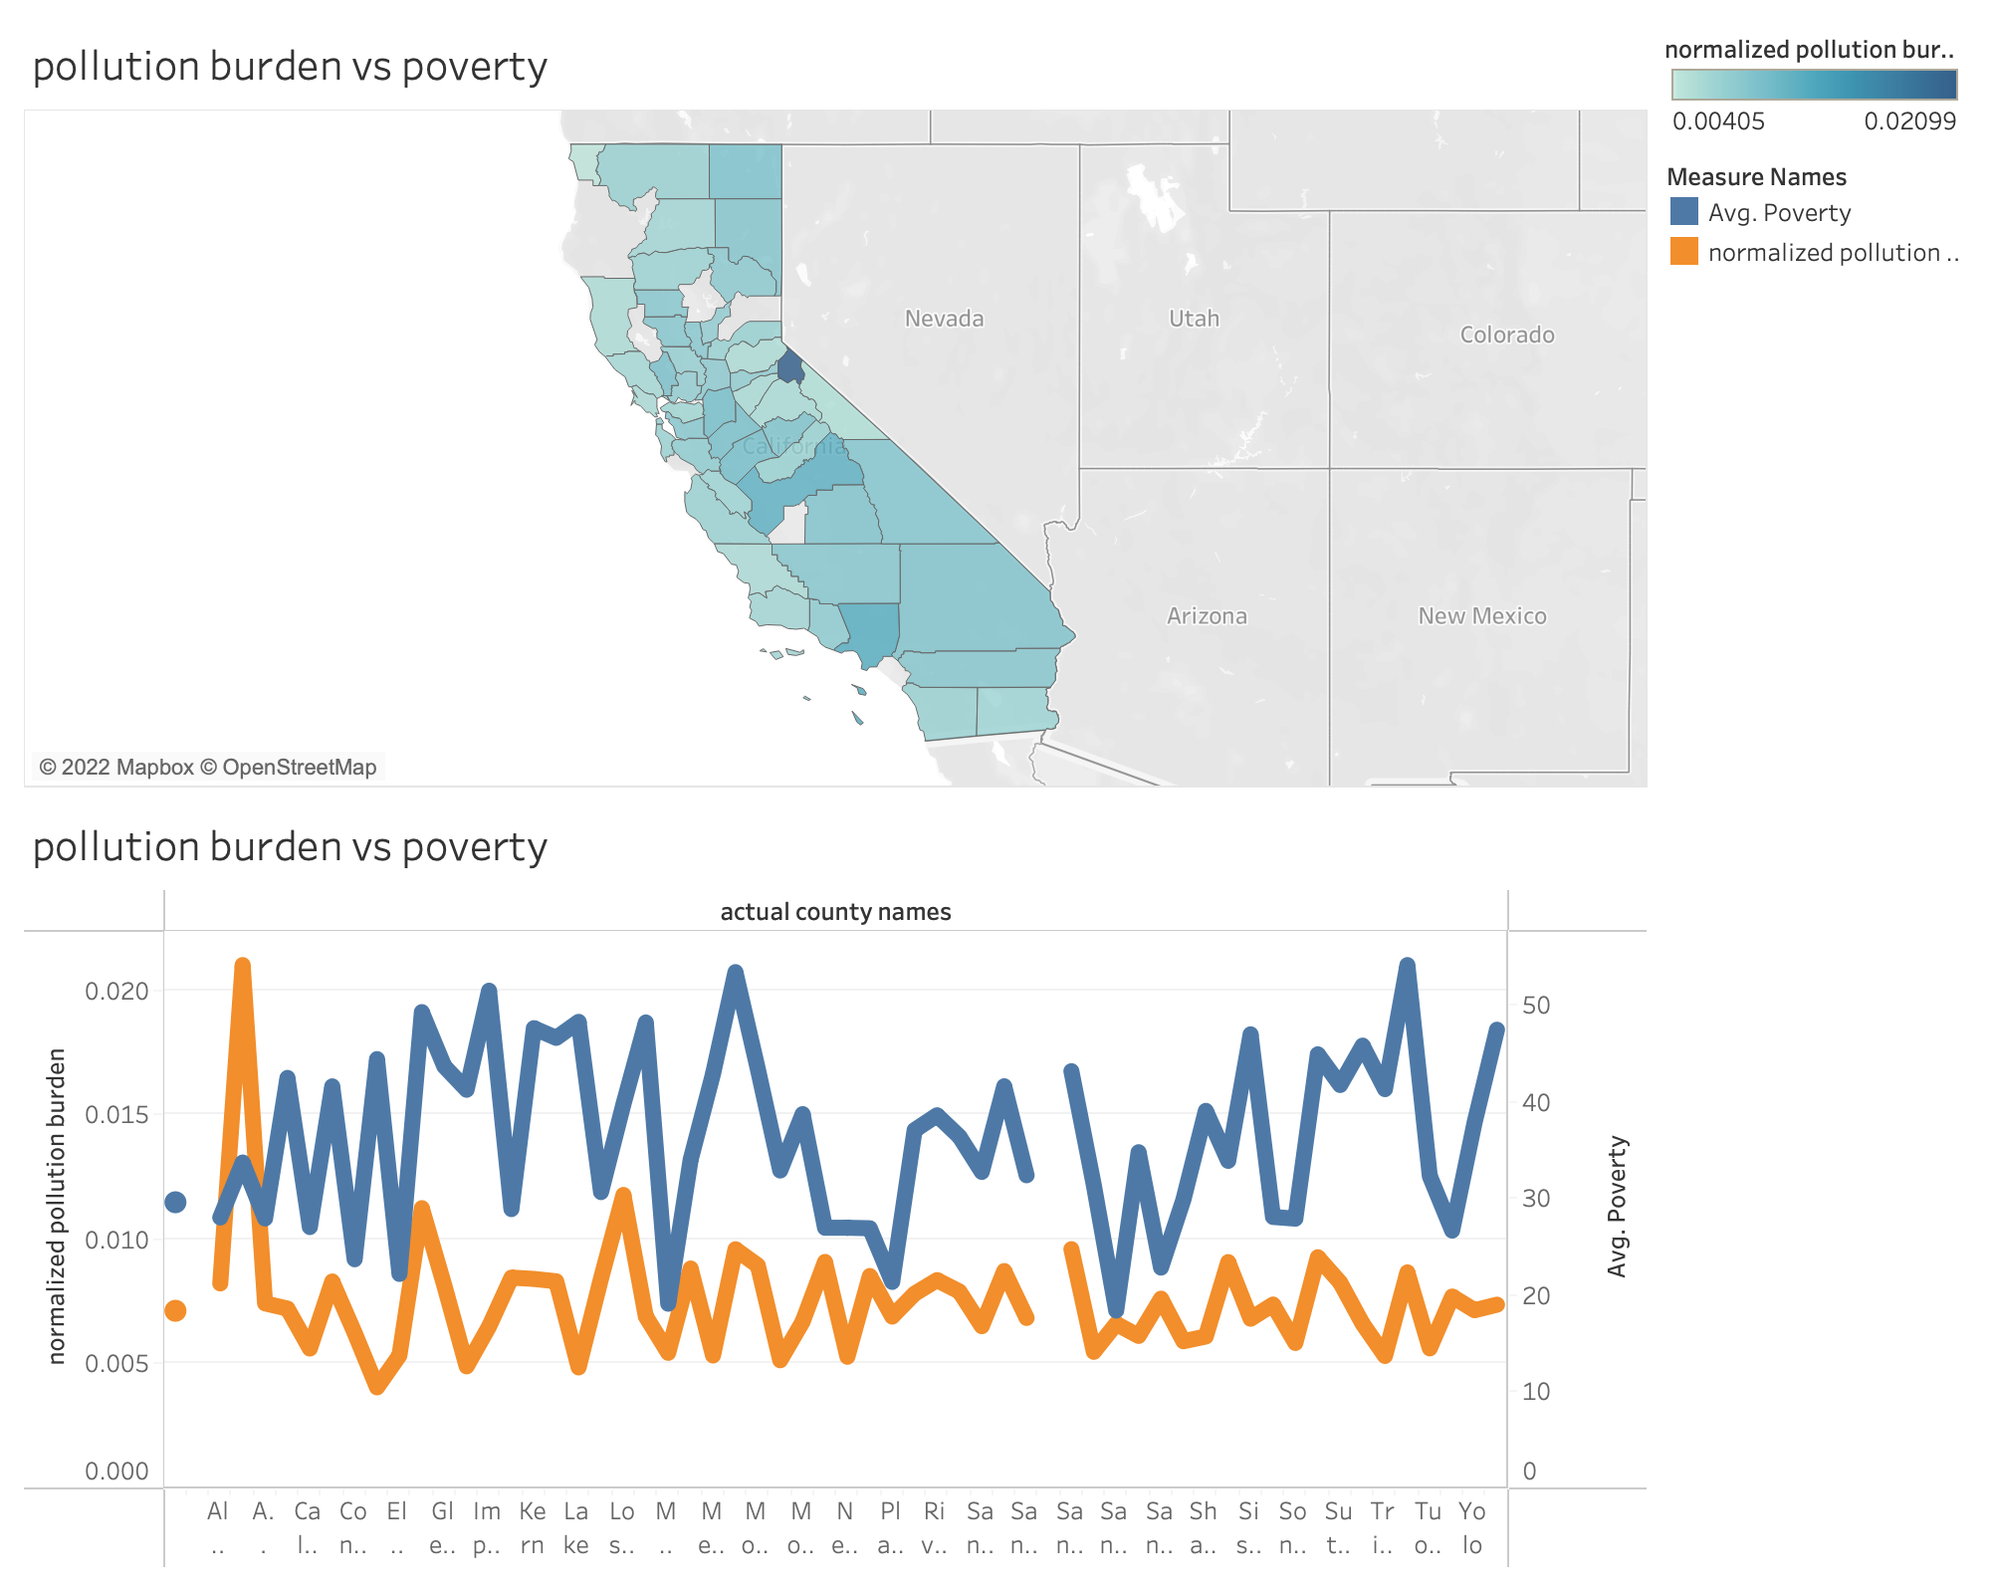
2. Pollution burden vs poverty by counties
Alpine County has a peak pollution burden.
Align with average poverty level for the counties

Slide 12
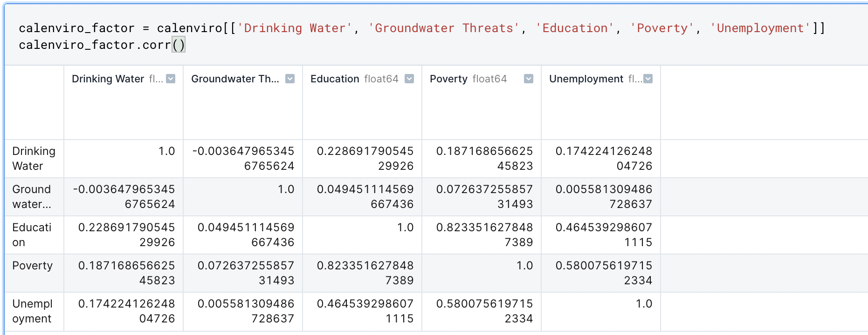
3. Socioeconomic factors and water pollution
Weak correlation between socioeconomic factors and drinking water contamination in ‘CalEnviroScreen dataset’

Slide 13
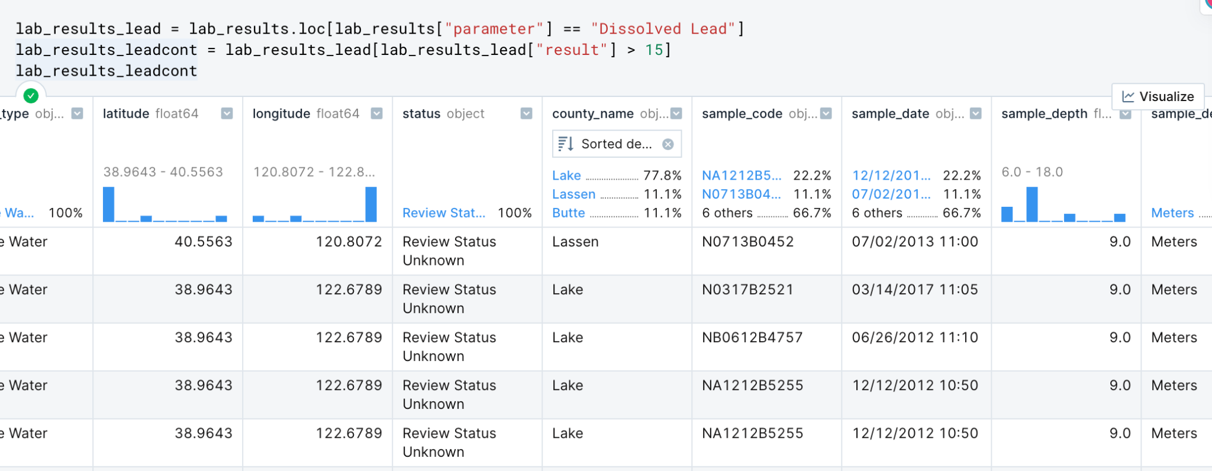
4. Toxic chemicals in surface water
The most harmful chemical ‘Dissolved Lead’ based on different counties in CA

Slide 14
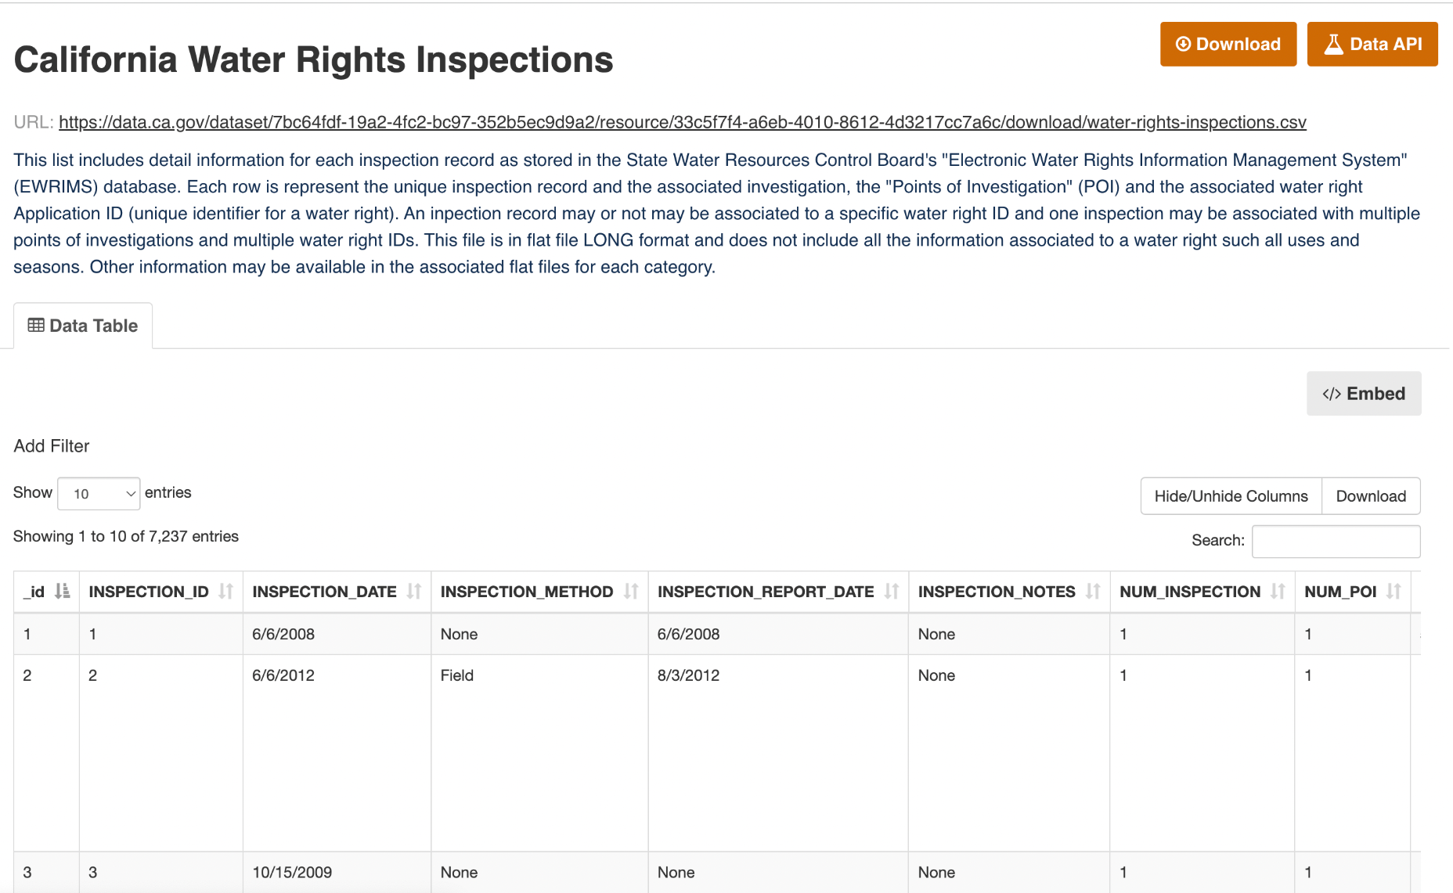
5. Water right permit
Lack of water right in CA
Need to depend on water rights to gain more water
Getting a water right permit is expensive

Slide 15
4. The Water Monitoring Dichotomy
Why are our results inconsistent?

Slide 16
Water Monitoring in California
Wealthier regions of CA had greater access to safe water as well as more access to water quality data
Contrarily, rural regions of CA had less access to safe water and less access to water quality data
Water monitoring probes, gauges and meters must continue towards a more affordable future

Slide 17
Conclusions
What are the implications of these findings?

Slide 18
Limits and solutions
Limits
Lack of data with other socioeconomic factors
Couldn’t find the relationship between the location and toxic chemical measurements
Lack of water right variables in dataset
Solutions
Analyzing with more socioeconomic factors (e.g. income levels)
Need more data to describe the reason of a lot of lead in certain areas
More variables (income of individuals, how they use water right, distribution, etc.)

Slide 19
Thank you so much!
Any questions?

